Slide 1
A Comprehensive Survey of Multi-Agent Reinforcement Learning

Slide 2
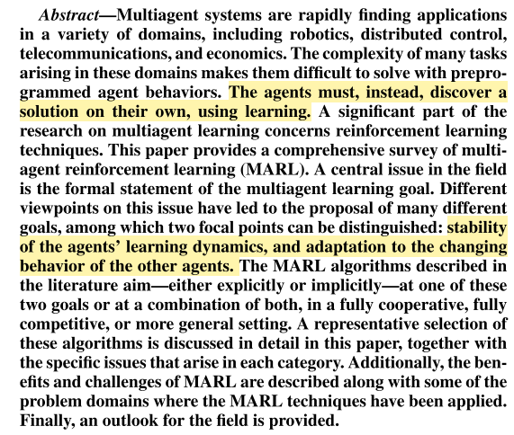
Abstract

Slide 3
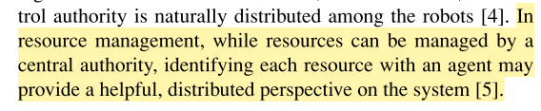
Introduction
Central System
Distributed System

Slide 4
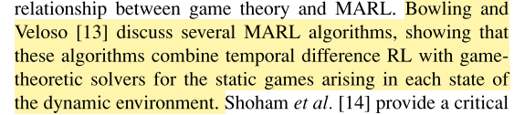
Related Work
MARL is highly related to Game Theory (Multi-Agent Systems).
The main difference is:
MARL focuses on dynamic multi-agent tasks, whereas,
Game theory deals with static (stateless) one-shot or repeated tasks.

Slide 5
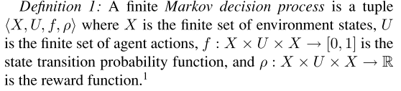
Background: Reinforcement Learning
Single Agent Case
Model based
Model free
Q learning
Exploration and exploitation
Epsilon-greedy
Boltzmann exploration strategy*

Slide 6

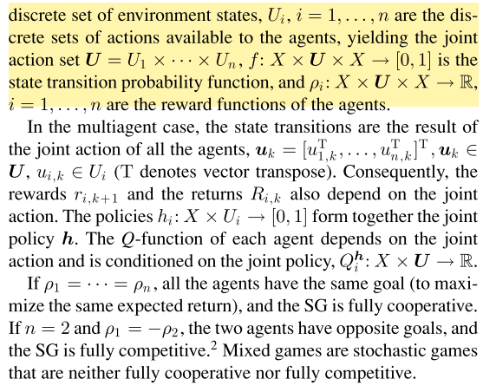
Single Agent Case
Multi-Agent Case
The generalization of Markov Decision Process in multi-agent case is the Stocastic Game.

Slide 7

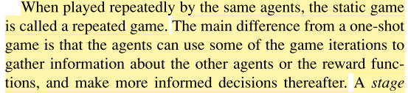

Single Agent Case
Multi Agent Case
Static, Repeated and Stage games

Slide 8
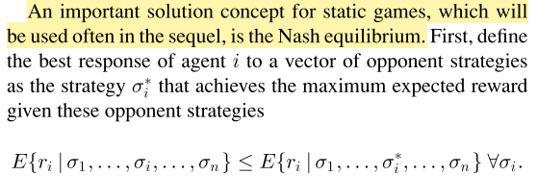
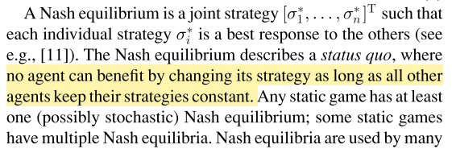
Nash Equilibrium

Slide 9
Benefits of MARL
Parallel computing
Experience sharing
Robustness (inherent)
High Scalability

Slide 10
Challenges in MARL
The curse of dimensionality
Specifying a goal
Nonstationarity
Exploration-exploitation trade off
Coordination

Slide 11

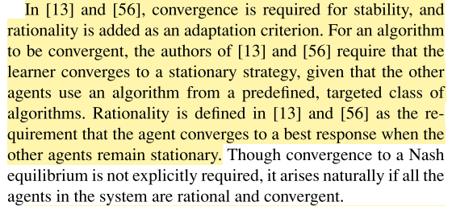
MARL Learning Goal
Stability of learning dynamics
Adaptation to the dynamic behaviour of the other agents

Slide 12
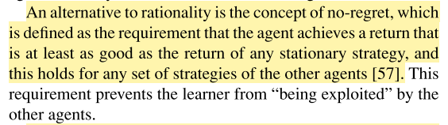
No regret: alternative to rationality (adaptation)

Slide 13
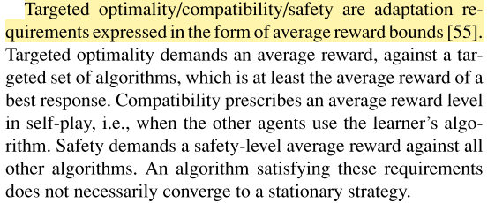
Targeted optimality/compatibility/safety

Slide 14
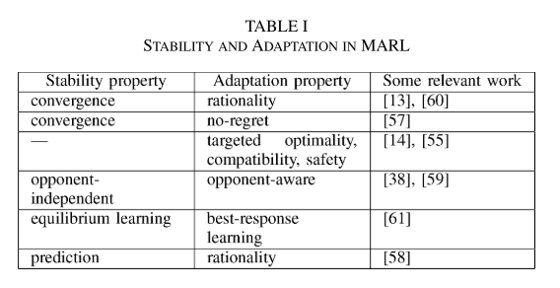
Stability and Adaptation in MARL

Slide 15
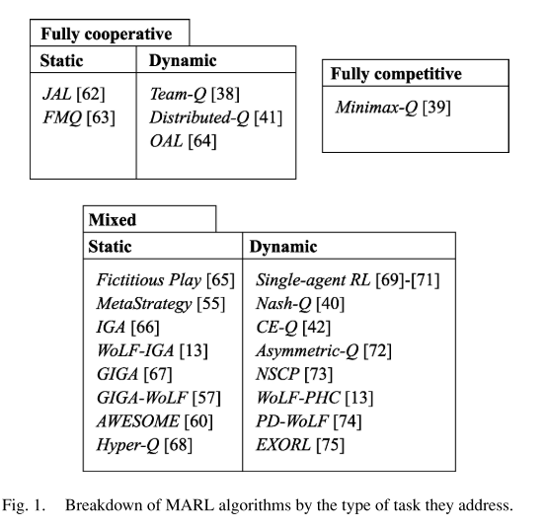
Taxonomy of MARL Algorithms
Task Based
Fully cooperative,
Fully competitive,
Mixed

Slide 16
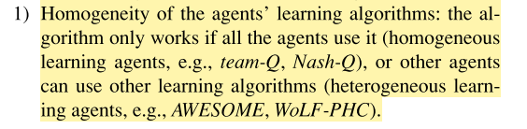
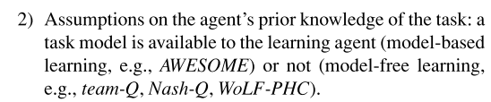
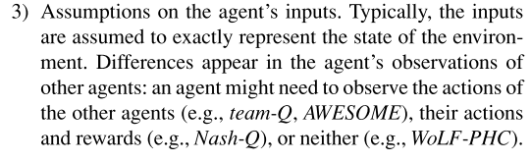
Homogeneity
Homogeneous
Heterogeneous
Assumption on the agent’s prior knowledge of the task:
Model based
Model free
Assumption on the agent’s inputs: An agent might need to observe:
Actions of other agents
Actions and rewards
Neither

Slide 17
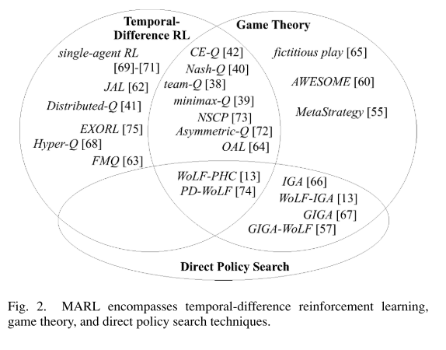

Slide 18
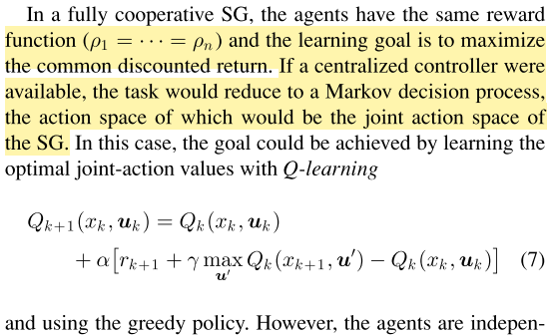
MARL Algorithms
Fully Cooperative tasks

Slide 19
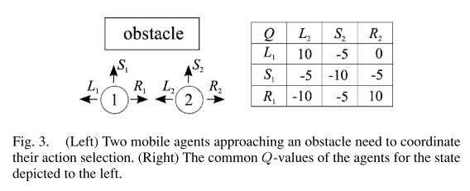
Need for coordination (Example 1)

Slide 20
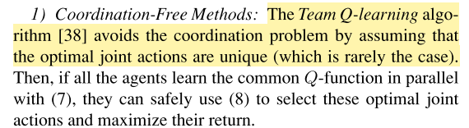
Coordination free methods
Team Q Learning

Slide 21
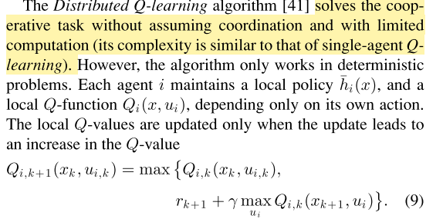
Distributed Q Learning
The local policy is updated only if the update leads to an improvement in the Q-values

Slide 22
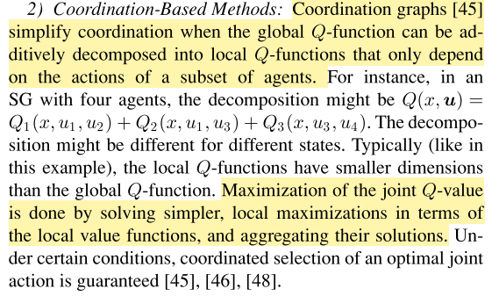
Coordination Based methods

Slide 23
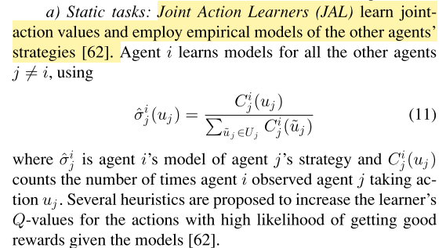
Indirect Coordination methods
They bias action selection towards actions that are likely to result in good rewards or returns.
JAL

Slide 24
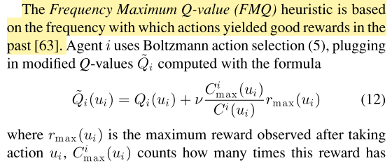

FMQ

Slide 25
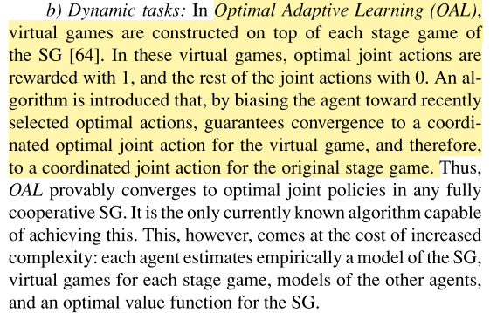
OAL

Slide 26
Remarks and Open issues
Exact measurements of state
Communication might be useful
Exact measurements of actions
Communication might be useful
Curse of dimensionality
Not in Distributed Q Learning and FMQ

Slide 27
Explicit Coordination Mechanisms
A general approach to solving the coordination problem is to make sure that ties are broken by all agents in the same way.
Social Conventions
Roles
Communication
Online learning of Coordination

Slide 28
Example 2
If agent 1 < agent 2 -> social convention

Slide 29
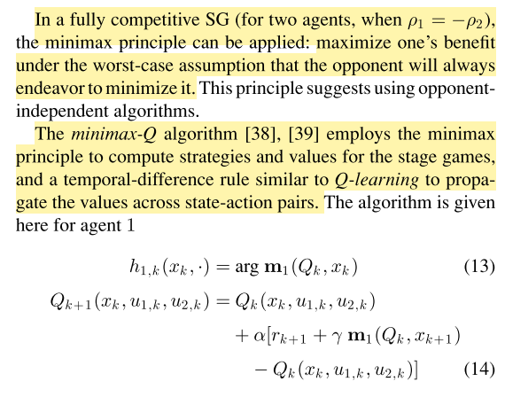
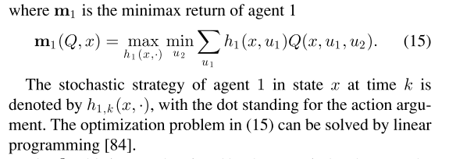
Fully Competitive tasks
Minimax Q learning

Slide 30
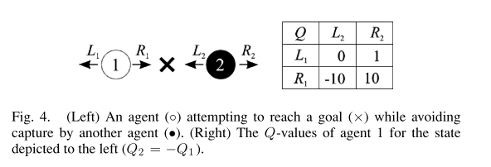
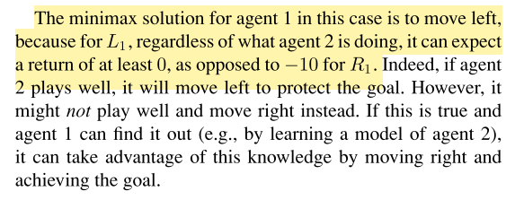
Example 3

Slide 31
Mixed Tasks
In mixed SGs, no constraints are imposed on reward functions of agents.
The influence of game theoretic concepts, like equilibrium concepts, is the strongest in mixed SGs. Also, when multiple equilibria exist in a particular state of an SG, the equilibrium selection problem arises: the agents need to consistently pick their part of the same equilibrium.
A significant number of algorithms in this category are designed only for static tasks (i.e., repeated general-sum games). In repeated games, one of the essential properties of RL, delayed rewards, is lost.

Slide 32
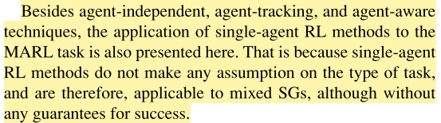
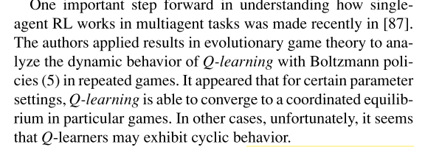
Single Agent RL

Slide 33
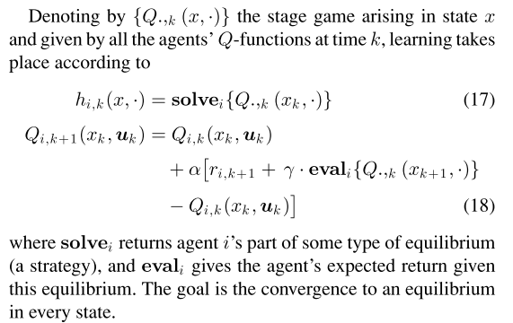
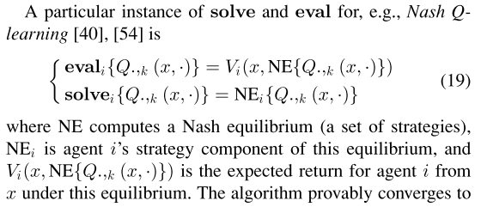
Agent Independent Methods
Algorithms that are independent of the other agents share a common structure based on Q-learning, where policies and state values are computed with game-theoretic solvers for the stage games arising in the states of the SG. Solvers can be different from minimax.

Slide 34
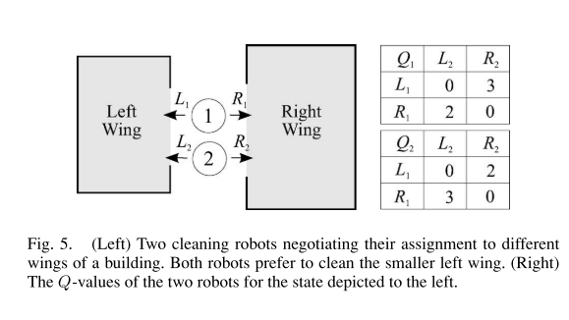
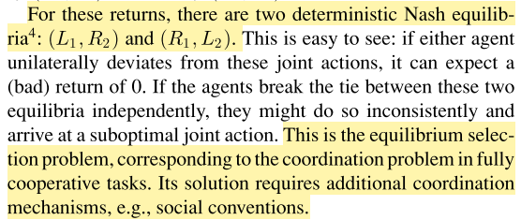
Example 4

Slide 35
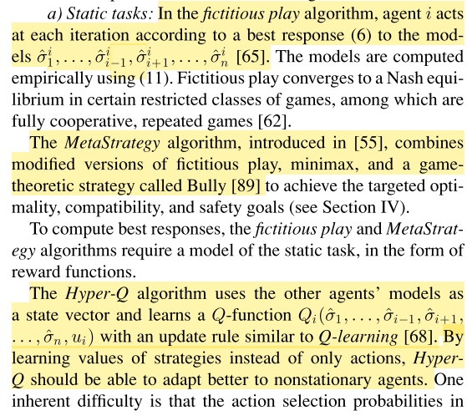
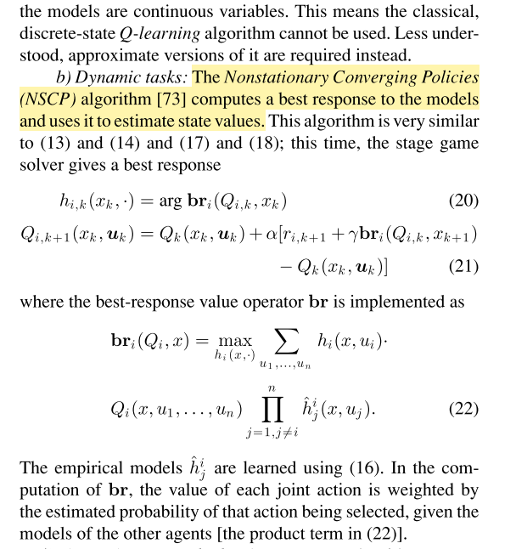
Agent Tracking Methods
Models of the other agents’ strategies or policies (depending on whether static or dynamic games are considered) are estimated and action taken is using some form of best-response to these models.

Slide 36
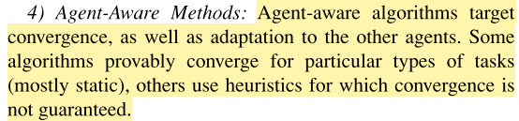
Agent Aware Methods
AWESOME
WoLF -IGA
WoLF-PHC
EXORL

Slide 37
Remarks and Open Issues
Limited Applications
Availability of exact task model is assumed
Game Theory creates a bias towards static (stage-wise) solutions in the dynamic case
Understanding the conditions under which single agent RL works in mixed SGs

Slide 38
Applications
Distributed Control
Robotic Teams
Automated Trading
Resource Management

Slide 39
Practical MARL
Scalability (Approximate RL)
Knowledge about task structure and sub-tasks can then be solved (Hierarchical RL)
Incomplete, uncertain state measurements (POMDP)

Slide 40
Conclusions
Multi-agent Reinforcement Learning is a young, but active and rapidly expanding field of research.
Significant progress in the field of multi-agent reinforcement learning can be achieved by a more intensive cross-fertilization between the fields of machine learning, game theory and control theory.

